Slide 1

Unveiling the Secret Life of the Galaxies with Microsoft Azure
David Rodríguez - @davidjrh
Adonai Suárez - @adonaisg
Sebastián Hidalgo
Foto: Daniel López

Slide 2
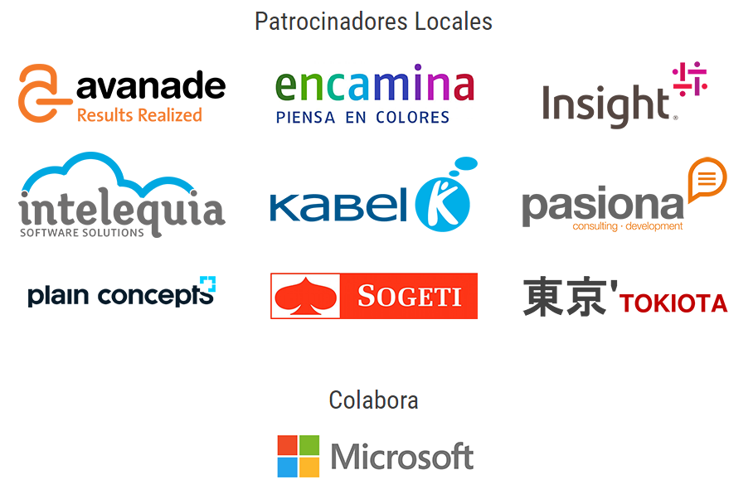
Thanks!

Slide 3
Agenda
Searching for an algorithm
Science Lab – Under the Hood
Azure Automation
Azure Batch
App Service, SQL Database & Application Insights
Traffic Manager
Event Hubs & Stream Analytics
Continuous Integration & Continuous Deployment

Slide 4
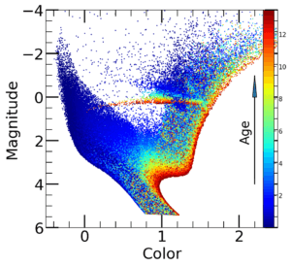
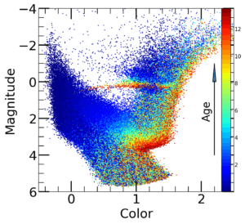

Searching for an algorithm for the GAB
Non profit
Research for the future of the humanity
Huge quantity of data to process
Ability to run in batches
Real time simulations doesn’t fit well
SELIGA: The SEcret LIfe of the GAlaxies

Slide 5
Science Lab
Designing a globally distributed compute farm

Slide 6
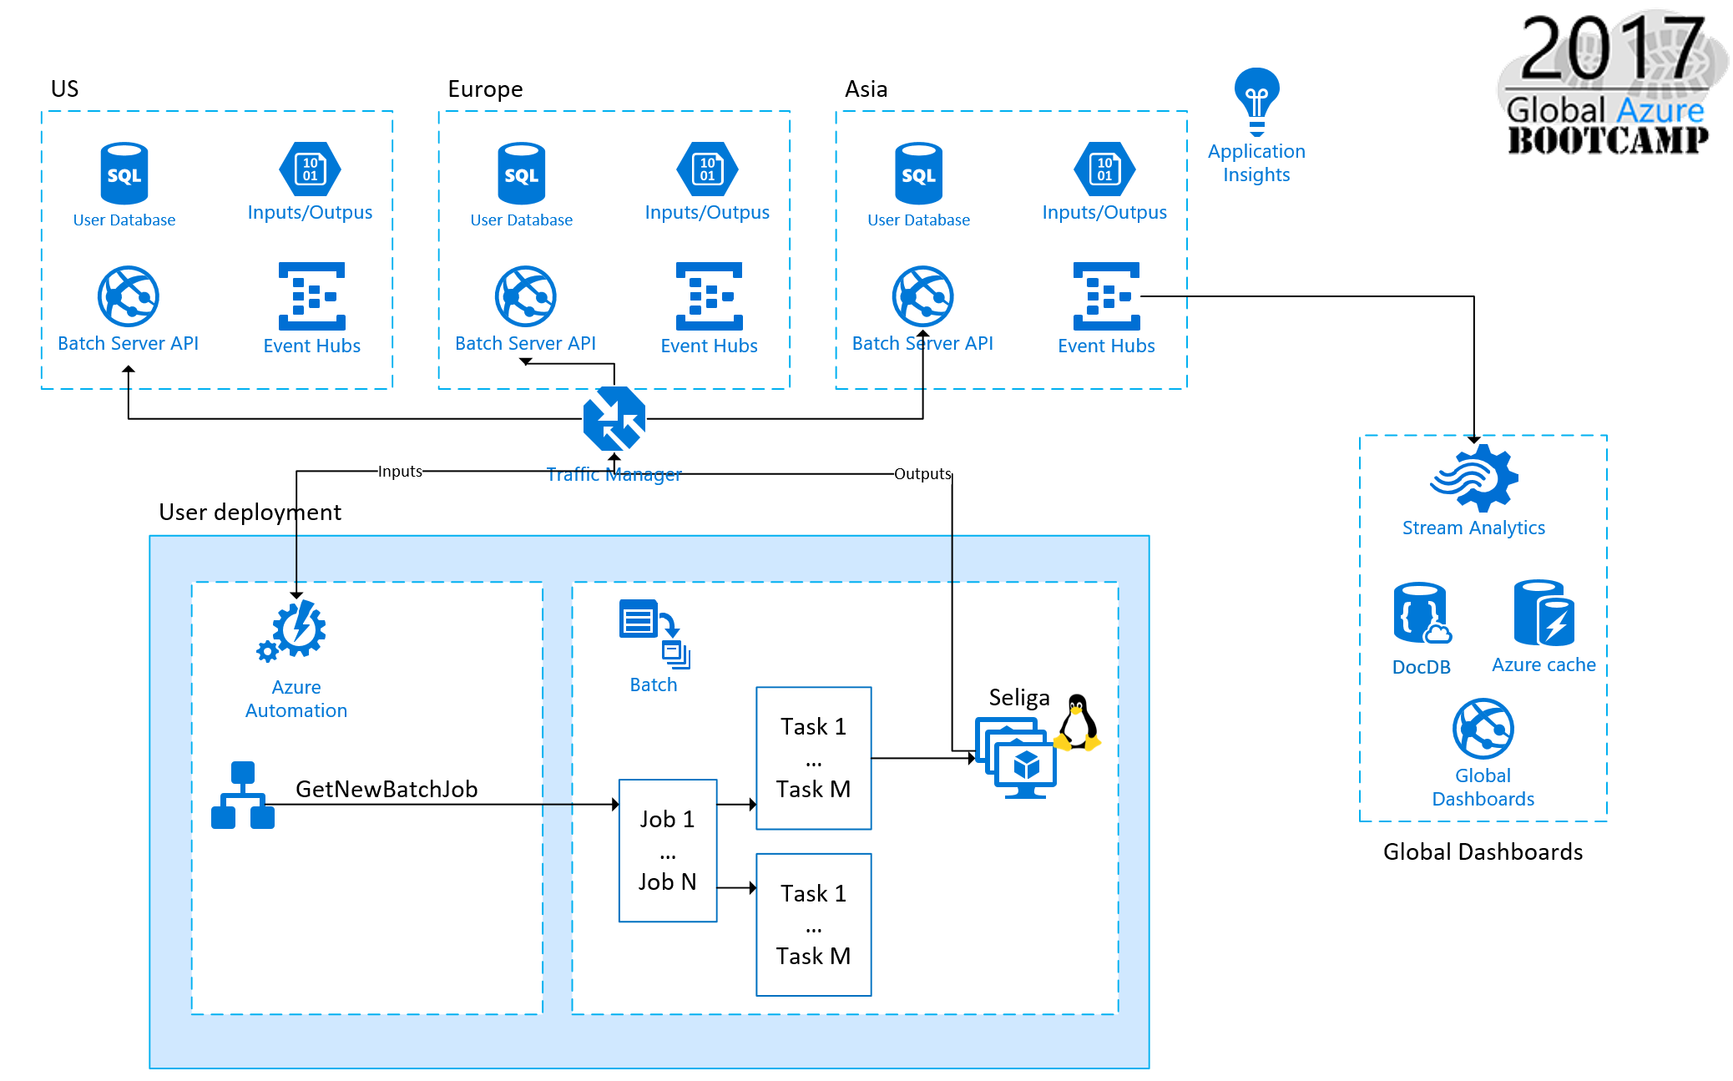

Slide 7
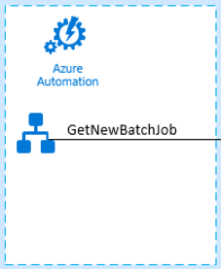
Azure Automation
Scenarios
Create VMs, continuous deployment, shutdown underused VMs
Runbooks
Set of tasks that perform some automated process
What can runbooks automate?
Based on PowerShell, Modules, Azure and external resources
Runbook Gallery
Microsoft Team and Community Runbooks
Key Benefits:
Save time and money
Integrate with any service
Avoid human errors

Slide 8
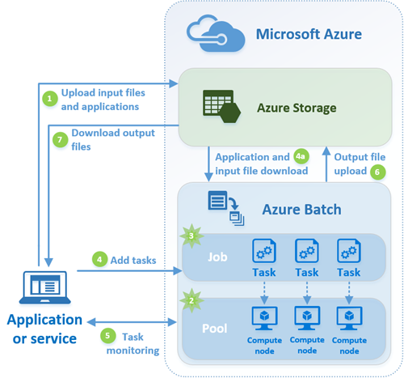
Azure Batch
Batch computing power on demand
Batch is available when you need it. Pay for what you use without an initial capital investment.
Choose your OS and tools
Windows, GNU Linux. SDK available for Python, Java and more.
High scalable
Scale manually or autoscale to 10s, 100s o 1000s VMs
Key Benefits:
Process amount of data easily
No cost by the service

Slide 9
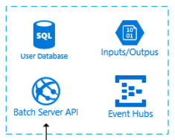
The Batch Server API
App Service to run the Batch API
.NET Core, EF, Swagger
SQL Database to store state
Lab users, Inputs, Outputs
Storage Account
+17 million Inputs and Ouputs
Application Insights
Telemetry
Key Benefits:
Easy compute scaling
Easy DB scaling
Cheap storage
Immediate knowledge of the App status

Slide 10
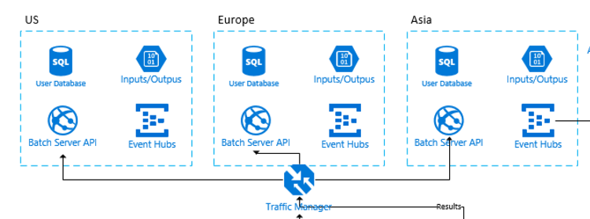

Traffic Manager
Distribute user lab traffic over multiple locations
Traffic Manager can direct your customer traffic to distribute it across multiple locations. We used geographical distribution.
Key Benefits:
Best performance
B Plan in case of location outage

Slide 11
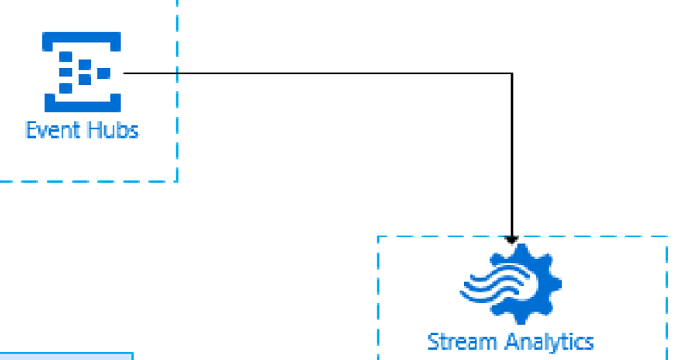
Event Hubs & Stream Analytics
Millions of events processed in realtime
Easy processing via Stream Analytics directly to the global dashboards
Elastic scale
Key Benefits:
Easy scaling
Multiple copies of the results using Stream Analytics
Real-time dashboards

Slide 12
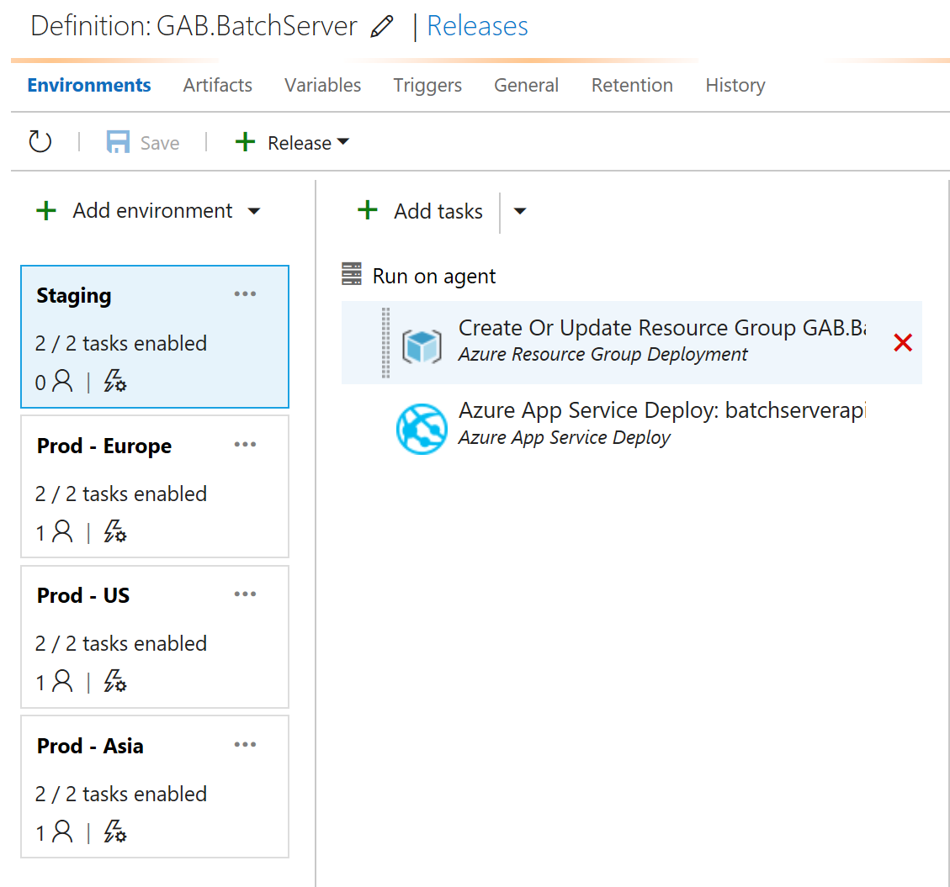
CI/CD with Visual Studio Team Services
Continuous Integration
Each commit fires a new build on VSTS
Continuous Delivery
Each build goes directly to the Staging Environment
Manual approval to publish worldwide (Europe, US, Asia)
Release history
Load Tests

Slide 13
Lessons learned
Azure APIs ahead of PowerShell CmdLets
But Microsoft loves Open Source, do a pull request!
Missing basic ARM template functions
But you can build an API generating a dynamic template with your needs
Copying millions of small files take days/weeks
Use multiple VMs with AzCopy /NC:512
Check the globally available resources
Automation Accounts not available everywhere, VM SKUs per location, etc.

Slide 14
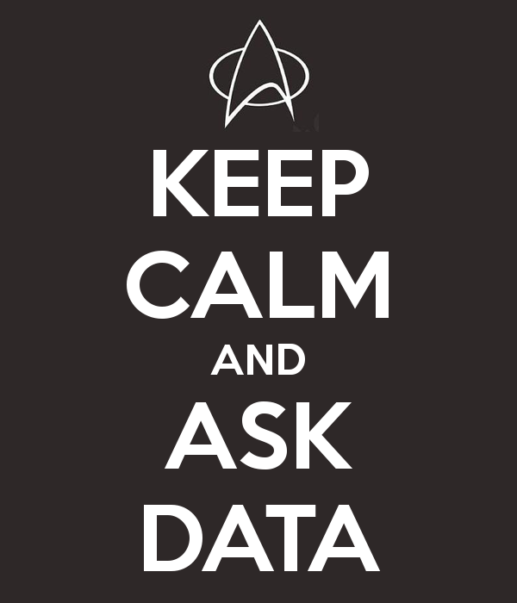
Questions?
@davidjrh
@adonaisg
Notes:
TODOS

Slide 15
Resources
GAB Science Lab deployment
https://github.com/intelequia/GAB2017ScienceLab
GAB Science Lab source code
https://github.com/intelequia/GAB2017ScienceLab/src

